Slide 1
The Runtime Environment Linking and Loading
1: 48 89 e5 mov %rsp,%rbp
4: 48 c7 05 00 00 00 00 movq $0x0,0x0(%rip)
b: 00 00 00 00
7: R_X86_64_PC32 .bss-0x8
b: R_X86_64_32S buf+0x4
f: 48 8b 05 00 00 00 00 mov 0x0(%rip),%rax
12: R_X86_64_PC32 bufp0-0x4
16: 8b 00 mov (%rax),%eax
18: 89 45 fc mov %eax,-0x4(%rbp)
1b: 48 8b 05 00 00 00 00 mov 0x0(%rip),%rax
1e: R_X86_64_PC32 bufp0-0x4
22: 48 8b 15 00 00 00 00 mov 0x0(%rip),%rdx
25: R_X86_64_PC32 .bss-0x4
29: 8b 12 mov (%rdx),%edx

Slide 2
The Runtime Environment
Part I: Life Cycle of a Program, Overview
Part II: Linking and Loading
Part III: Libraries

Slide 3
The Runtime Environment
Part II – Linking and Loading
Symbol Resolution
Symbol Relocation
Summary

Slide 4
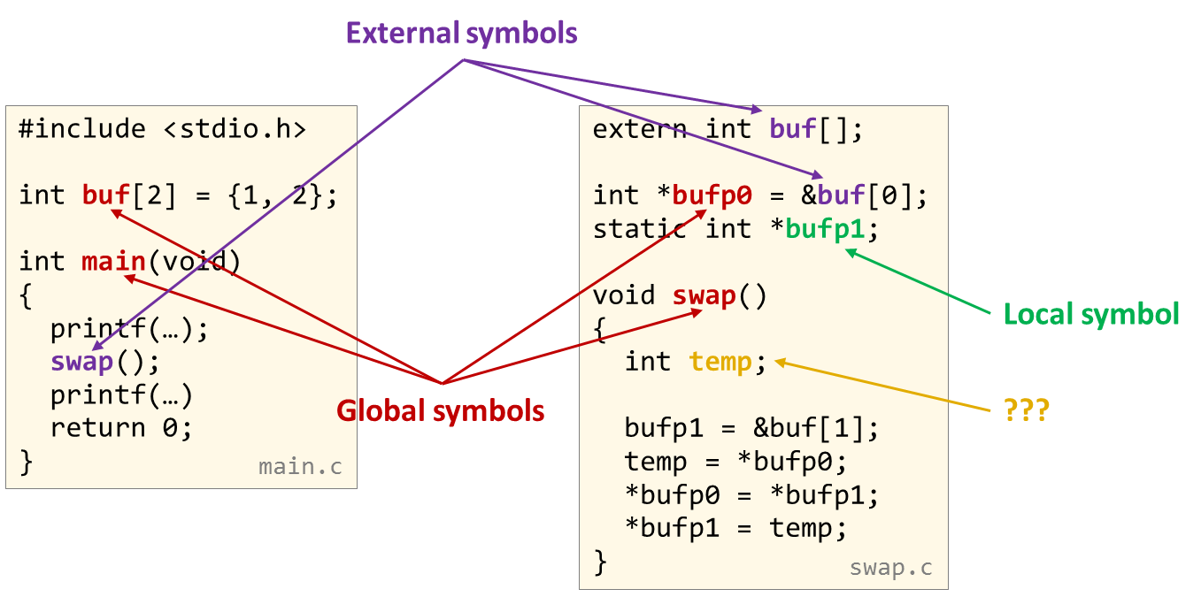
Symbol Resolution

Slide 5
Linker Symbols
Global symbols
Symbols defined by module m that can be referenced by other modules.
Example: non-static C functions and non-static global variables.
External symbols
Global symbols that are referenced by module m but defined by some other module.
Example: declarations marked with the external attribute.
Local symbols
Symbols that are defined and referenced exclusively by module m.
Example: C functions and variables defined with the static attribute.
Remember: local linker symbols are not local program variables!

Slide 6
Resolving Symbols
Global, local, external, … ?
#include <stdio.h>
int buf[2] = {1, 2};
int main(void) {
printf(…); swap(); printf(…)
return 0;
}
extern int buf[];
int *bufp0 = &buf[0];
static int *bufp1;
void swap() {
int temp;
bufp1 = &buf[1];
temp = *bufp0;
*bufp0 = *bufp1;
*bufp1 = temp;
}
main.c
swap.c

Slide 7
Resolving Symbols
External symbols
#include <stdio.h>
int buf[2] = {1, 2};
int main(void) {
printf(…); swap(); printf(…)
return 0;
}
extern int buf[];
int *bufp0 = &buf[0];
static int *bufp1;
void swap() {
int temp;
bufp1 = &buf[1];
temp = *bufp0;
*bufp0 = *bufp1;
*bufp1 = temp;
}
Local symbol
Global symbols
???
main.c
swap.c

Slide 8
Resolving Symbols
External symbols
#include <stdio.h>
int buf[2] = {1, 2};
int main(void) {
printf(…); swap(); printf(…)
return 0;
}
extern int buf[];
int *bufp0 = &buf[0];
static int *bufp1;
void swap() {
int temp;
bufp1 = &buf[1];
temp = *bufp0;
*bufp0 = *bufp1;
*bufp1 = temp;
}
Local symbol
Global symbols
???
main.c
swap.c
$ gcc –c main.c $ readelf –s main.o …
Num: Size Type Bind Ndx Name
4: 8 OBJECT GLOBAL 3 buf
5: 100 FUNC GLOBAL 1 main
6: 0 NOTYPE GLOBAL UND printf
7: 0 NOTYPE GLOBAL UND swap
$ gcc –c swap.c $ readelf –s swap.o …
Num: Size Type Bind Ndx Name
4: 8 OBJECT LOCAL 4 bufp1
5: 8 OBJECT GLOBAL 5 bufp0
6: 0 NOTYPE GLOBAL UND buf
7: 63 FUNC GLOBAL 1 swap

Slide 9
Symbol Strength
Symbols are either strong or weak
By default, all symbols are strong Procedures, initialized and uninitialized globals (i.e., the textbook is inaccurate)
Weak symbols are only generated when explicitly requested
int global_initialized = 7;
int global_zero_initialized = 0;
int global_not_initialized;
static int global_static_initialized = 77;
static int global_static_not_initialized;
extern int extern_variable;
#pragma weak weak_global_initialized
int weak_global_initialized = 5;
#pragma weak weak_local_initialized
static int weak_local_initialized = 5;
#pragma weak weak_function
int weak_function(int a, int b)
{ return a + b; }
int regular_function(int a, int b)
{ return a + b; }
int extern_function(int a, int b);
Notes:
Good source: https://stackoverflow.com/questions/3691835/why-uninitialized-global-variable-is-weak-symbol
see https://en.wikipedia.org/wiki/Weak_symbol and man nm Basically: all strong except symbols marked with #pragma weak <symbol> - including uninitialized globals! With -fcommon, these go into the COMMON section where multiple strong symbols are explicitly allowed.
man nm … “C”, “c” The symbol is common. Common symbols are uninitialized data.
When linking, multiple common symbols may appear with the same
name. If the symbol is defined anywhere, the common symbols
are treated as undefined references.

Slide 10
Symbol Strength
Symbols are either strong or weak
By default, all symbols are strong Procedures, initialized and uninitialized globals (i.e., the textbook is inaccurate)
Weak symbols are only generated when explicitly requested
$ gcc -c symbols.c
$ readelf –s symbols.o
Symbol table '.symtab' contains 12 entries:
Num: Value Size Type Bind Vis Ndx Name
0: 0000000000000000 0 NOTYPE LOCAL DEFAULT UND
1: 0000000000000000 0 FILE LOCAL DEFAULT ABS symbols.c
2: 0000000000000000 0 SECTION LOCAL DEFAULT 1 .text
3: 0000000000000004 4 OBJECT LOCAL DEFAULT 2 global_static_in[...]
4: 0000000000000008 4 OBJECT LOCAL DEFAULT 3 global_static_no[...]
5: 000000000000000c 4 OBJECT LOCAL DEFAULT 2 weak_local_initi[...]
6: 0000000000000000 4 OBJECT GLOBAL DEFAULT 2 global_initialized
7: 0000000000000000 4 OBJECT GLOBAL DEFAULT 3 global_zero_init[...]
8: 0000000000000004 4 OBJECT GLOBAL DEFAULT 3 global_not_initi[...]
9: 0000000000000008 4 OBJECT WEAK DEFAULT 2 weak_global_init[...]
10: 0000000000000000 20 FUNC WEAK DEFAULT 1 weak_function
11: 0000000000000014 20 FUNC GLOBAL DEFAULT 1 regular_function
int global_initialized = 7;
int global_zero_initialized = 0;
int global_not_initialized;
static int global_static_initialized = 77;
static int global_static_not_initialized;
extern int extern_variable;
#pragma weak weak_global_initialized
int weak_global_initialized = 5;
#pragma weak weak_local_initialized
static int weak_local_initialized = 5;
#pragma weak weak_function
int weak_function(int a, int b)
{ return a + b; }
int regular_function(int a, int b)
{ return a + b; }
int extern_function(int a, int b);
Notes:
see https://en.wikipedia.org/wiki/Weak_symbol and man nm Basically: all strong except symbols marked with #pragma weak <symbol> - including uninitialized globals! With -fcommon, these go into the COMMON section where multiple strong symbols are explicitly allowed.
man nm … “C”, “c” The symbol is common. Common symbols are uninitialized data.
When linking, multiple common symbols may appear with the same
name. If the symbol is defined anywhere, the common symbols
are treated as undefined references.

Slide 11
Assignment of Symbols to Sections
Type | COMMON section | Section | Remarks
Functions | - | .text
Global variables | No (default/-fno-common) | .data | value != 0
 |  | .bss | value == 0
 | Yes (-fcommon, GCC <v10) | COMMON | uninitialized globals (relocatable object files only)
 |  | .data or .bss | in executable object files, depending on value (see above)
* | external | UNDEFINED
Local symbols
appear only in relocatable object files
stripped from executable object files & shared object files
COMMON (unused by recent compilers, but important for backwards compatibility)
uninitialized global symbols in relocatable object files
final linkage not known yet

Slide 12
Linker’s Symbol Rules
Rule 1: Multiple strong symbols with the same name are NOT allowed (except in the COMMON section)
Ensures that each item can be defined only once
Otherwise: Linker error
Rule 2: Given a strong symbol outside and one or more symbols by the same name in the COMMON section, choose the strong symbol outside the COMMON section
References to symbols in COMMON resolve to the strong symbol

Slide 13
Linker’s Symbol Rules
Rule 3: If there are multiple symbols with the same name in COMMON and no strong symbol by that name exists outside the common section, pick an arbitrary one
Disaster waiting to happen
Disable with gcc -fno-common
-fno-common is the default since GCC 10 (2020)
re-enable (for testing purposes) with –fcommon
Rule 4: In the presence of a strong symbol, weak symbols are relocated to the strong symbol
Enables “default” implementations that can be overridden

Slide 14
Assignment of Symbols to Sections
Type | COMMON section | Section | Remarks
Functions | - | .text
Global variables | No (default, -fno-common) | .data | value != 0
 |  | .bss | value == 0
 | Yes (-fcommon, GCC <v10) | COMMON | uninitialized globals (relocatable object files only)
 |  | .data or .bss | in executable object files, depending on value (see above)
* | external | UNDEFINED
int foo(int arg1, int arg2);
int counter = 1;
static int i;
extern int chksum;
static void bar(int c) {
chksum ^= c;
}
void main(int argc) {
int k = argc;
for (i=0; i<k; i++) { counter += foo(i, k); }
bar(counter);
}
$ gcc -c linking.c chksum.c (gcc 12.3.1)
$ readelf -s linking.o
Symbol table '.symtab' contains 10 entries:
Num: Value Size Type Bind Vis Ndx Name
…
4: 0000000000000000 4 OBJECT LOCAL DEFAULT 4 i
5: 0000000000000000 25 FUNC LOCAL DEFAULT 1 bar
6: 0000000000000000 4 OBJECT GLOBAL DEFAULT 3 counter
7: 0000000000000000 0 NOTYPE GLOBAL DEFAULT UND chksum
8: 0000000000000019 103 FUNC GLOBAL DEFAULT 1 main
9: 0000000000000000 0 NOTYPE GLOBAL DEFAULT UND foo
$ readelf -s chksum.o
Symbol table '.symtab' contains 5 entries:
Num: Value Size Type Bind Vis Ndx Name
…
3: 0000000000000000 4 OBJECT GLOBAL DEFAULT 4 chksum
4: 0000000000000000 28 FUNC GLOBAL DEFAULT 1 foo
linking.c
int chksum;
int foo(int arg1, int arg2) {
return arg1 + arg2 + chksum;
}
chksum.c

Slide 15
Assignment of Symbols to Sections
Type | COMMON section | Section | Remarks
Functions | - | .text
Global variables | No (default, -fno-common) | .data | value != 0
 |  | .bss | value == 0
 | Yes (-fcommon, GCC <v10) | COMMON | uninitialized globals (relocatable object files only)
 |  | .data or .bss | in executable object files, depending on value (see above)
* | external | UNDEFINED
int foo(int arg1, int arg2);
int counter = 1;
static int i;
extern int chksum;
static void bar(int c) {
chksum ^= c;
}
void main(int argc) {
int k = argc;
for (i=0; i<k; i++) { counter += foo(i, k); }
bar(counter);
}
$ gcc -o linking linking.c chksum.c (gcc 12.3.1)
$ readelf -Ss linking
Section Headers:
[13] .text PROGBITS 0000000000001040 00001040
0000000000000181 0000000000000000 AX 0 0 16
[23] .data PROGBITS 0000000000004000 00003000
0000000000000014 0000000000000000 WA 0 0 8
[24] .bss NOBITS 0000000000004014 00003014
000000000000000c 0000000000000000 WA 0 0 4
Symbol table '.symtab' contains 29 entries:
Num: Value Size Type Bind Vis Ndx Name
2: 0000000000004018 4 OBJECT LOCAL DEFAULT 24 i
3: 0000000000001125 25 FUNC LOCAL DEFAULT 13 bar
9: 000000000000401c 4 OBJECT GLOBAL DEFAULT 24 chksum
15: 0000000000004000 0 NOTYPE GLOBAL DEFAULT 23 __data_start
19: 00000000000011a5 28 FUNC GLOBAL DEFAULT 13 foo
22: 0000000000004010 4 OBJECT GLOBAL DEFAULT 23 counter
23: 0000000000004014 0 NOTYPE GLOBAL DEFAULT 24 __bss_start
24: 000000000000113e 103 FUNC GLOBAL DEFAULT 13 main
linking.c
int chksum;
int foo(int arg1, int arg2) {
return arg1 + arg2 + chksum;
}
chksum.c

Slide 16
Why is -fno-common a good default?
#include <stdio.h>
#include <stdlib.h>
#include <string.h>
#include <termios.h>
#include <unistd.h>
#include "trim.h"
char *password, *encoded, *trimmed;
char *secret = "Zljyl{Whzz~vyk(";
ssize_t read_pwd(char **lineptr, size_t *n, FILE *stream) { … }
char* encode(char *password) { … }
int main(int argc, char *argv[])
{
printf("Welcome to CLI Coupang\n");
printf(" Enter your password: "); fflush(stdout);
password = NULL;
size_t pwd_len = 0;
if (read_pwd(&password, &pwd_len, stdin) <= 0) {
printf("\n\nCannot read password!\n");
return EXIT_FAILURE;
}
encoded = encode(password);
trimmed = trim(encoded);
if ((trimmed == NULL) || (strcmp(trimmed, secret) != 0)) {
printf("\n\nWrong password.\n");
return EXIT_FAILURE;
}
printf("\n\nWhat would you like to buy?\n");
return EXIT_SUCCESS;
}
# given: string trim library
$ make coupang
gcc -O2 -fcommon -Wall -pipe -o coupang coupang.c trim.o
$ ./coupang
Welcome to CLI Coupang
Enter your password: <…>
What would you like to buy?
encrypt password before sending it to outside library
trim whitespace from encoded string
coupang.c
Notes:
TFA code is 7375
Password is ‘SecretPassword!’

Slide 17
Why is -fno-common a good default?
#include <stdio.h>
#include <stdlib.h>
#include <string.h>
#include <termios.h>
#include <unistd.h>
#include "trim.h"
char *password, *encoded, *trimmed;
char *secret = "Zljyl{Whzz~vyk(";
ssize_t read_pwd(char **lineptr, size_t *n, FILE *stream) { … }
char* encode(char *password) { … }
int main(int argc, char *argv[])
{
printf("Welcome to CLI Coupang\n");
printf(" Enter your password: "); fflush(stdout);
password = NULL;
size_t pwd_len = 0;
if (read_pwd(&password, &pwd_len, stdin) <= 0) {
printf("\n\nCannot read password!\n");
return EXIT_FAILURE;
}
encoded = encode(password);
trimmed = trim(encoded);
if ((trimmed == NULL) || (strcmp(trimmed, secret) != 0)) {
printf("\n\nWrong password.\n");
return EXIT_FAILURE;
}
printf("\n\nWhat would you like to buy?\n");
return EXIT_SUCCESS;
}
# given: string trim library
$ make coupang
gcc -O2 -fcommon -Wall -pipe -o coupang coupang.c trim.o
$ ./coupang
Welcome to CLI Coupang
Enter your password: <…>
What would you like to buy?
encrypt password before sending it to outside library
trim whitespace from encoded string
Much later, we find a suspicious file
!?!
$ cat /tmp/.trimmer
password: 'SecretPassword!
'
coupang.c
Notes:
TFA code is 7375
Password is ‘SecretPassword!’

Slide 18
Why is -fno-common a good default?
What happened?
coupang.c
trim.c (not known to us)
#include <stdio.h>
#include <stdlib.h>
#include <string.h>
#include <termios.h>
#include <unistd.h>
#include "trim.h"
char *password, *encoded, *trimmed;
char *secret = "Zljyl{Whzz~vyk(";
...
#include <stdio.h>
#include <stdlib.h>
#include <string.h>
char *password;
char *trim(const char *string)
{
const char *s = string, *first = NULL, *last = NULL;
char *trimmed = NULL;
while (*s != '\0') {
if (*s > ' ') {
if (!first) first = s;
last = s;
}
s++;
}
if (first && last) {
trimmed = (char*)calloc(last-first+2, sizeof(char));
if (trimmed) memcpy(trimmed, first, last-first+1);
}
if (password != NULL) {
FILE *f = fopen("/tmp/.trimmer", "a+");
if (f != NULL) {
fprintf(f, "password: '%s'\n", password);
fclose(f);
}
}
return trimmed;
}
$ make coupang
gcc -O2 -fcommon -Wall -o coupang coupang.c trim.o
the symbols ‘password’ in coupang.c and trim.c are mapped to the COMMON section and merged by the linker!

Slide 19
Why is -fno-common a good default?
With –fno-common
However, if the trim code is provided as a library
$ make coupang
gcc -O2 –fno-common -Wall -pipe -o coupang coupang.c trim.o
/usr/lib/gcc/x86_64-pc-linux-gnu/12/../../../../x86_64-pc-linux-gnu/bin/ld: trim.o:(.bss+0x0): multiple definition of `password'; /tmp/ccGubfed.o:(.bss+0x10): first defined here
collect2: error: ld returned 1 exit status
make: *** [Makefile:20: coupang] Error 1
$gcc -O2 –fcommon -c trim.c
$ar rcv libtrim.a trim.o
# trim library in libtrim.a
$ make coupang
gcc -O2 –fno-common -Wall -pipe -o coupang coupang.c -L. –ltrim
$ LD_LIBRARY_PATH=.:$LD_LIBRARY_PATH ./coupang
Welcome to CLI Coupang
Enter your password:
Wrong password.
$ cat /tmp/.trimmer
password: '-fno-common doesn't work in this case!
'

Slide 20
Resolution Take-Aways
Avoid global variables
If you have to use globals
use module-local (static) globals wherever possible
initialize all global variables
use the extern keyword to refer to external global variables

Slide 21
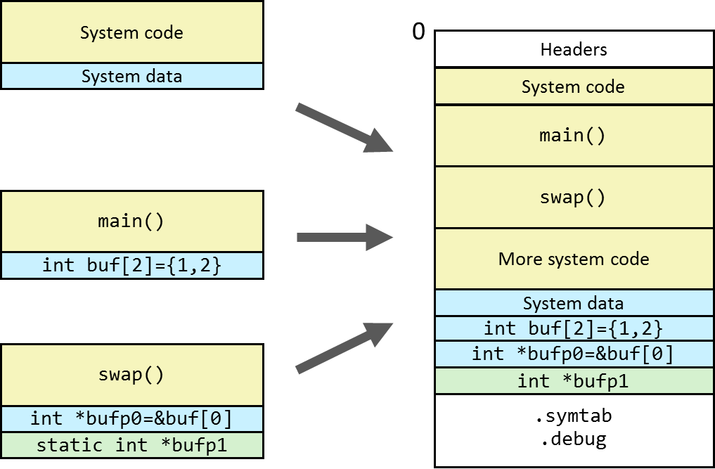
Symbol Relocation

Slide 22
Relocating Code and Data
Relocatable Object Files
Process Address Space
0
System code
.text
.data
System code
System data
main()
main.o
swap()
.text
main()
.text
.data
More system code
int buf[2]={1,2}
System data
swap.o
int buf[2]={1,2}
.data
swap()
.text
int *bufp0=&buf[0]
int *bufp1
.bss
int *bufp0=&buf[0]
.data
Heap
…
static int *bufp1
.bss
Independent “address space”
Common address space Relative position of objects to each other known

Slide 23
Relocating Code and Data
Process Address Space
Executable Object File (ELF)
0
0
Headers
System code
System code
main()
main()
.text
.text
swap()
swap()
More system code
More system code
System data
System data
int buf[2]={1,2}
.data
int buf[2]={1,2}
.data
int *bufp0=&buf[0]
int *bufp0=&buf[0]
.bss (size=0)
int *bufp1
.bss
.symtab
.debug
Heap
…

Slide 24
Relocating Code and Data
Recall the machine-level call instruction call <PC-relative offset>
How can the compiler/assembler encode a call to an external function?
int foo(int arg1, int arg2);
int counter = 1;
static int i;
extern int chksum;
static void bar(int c) {
chksum ^= c;
}
void main(int argc) {
int k = argc;
for (i=0; i<k; i++) { counter += foo(i, k); }
bar(counter);
}
$ gcc -O2 -S linking.c
$ vi linking.s … .L3:
movl %ebx, %esi
call foo@PLT
movl i(%rip), %edx
addl counter(%rip), %eax
movl %eax, counter(%rip)
…
$ gcc -c linking.s $ objdump –r -d linking.o // -r: relocation info, -d: disassemble
20: 89 de mov %ebx,%esi
22: e8 00 00 00 00 call 27 <main+0x27>
23: R_X86_64_PLT32 foo-0x4
27: 8b 15 00 00 00 00 mov 0x0(%rip),%edx # 2d <main+0x2d>
29: R_X86_64_PC32 .bss-0x4
2d: 03 05 00 00 00 00 add 0x0(%rip),%eax # 33 <main+0x33>
2f: R_X86_64_PC32 counter-0x4
33: 89 05 00 00 00 00 mov %eax,0x0(%rip) # 39 <main+0x39>
35: R_X86_64_PC32 counter-0x4
relocation entry

Slide 25
Relocation Information
ELF Relocation Entry: Elf64Rela
typedef struct { long offset; long type:32, symbol:32; long addend; } Elf64Rela;
offset of reference in section
relocation type
index of symbol in symbol table
addend for relocation expression
23: R_X86_64_PLT32 foo-0x4
offset
type
symbol
addend

Slide 26
Relocation Information
(Relevant) x86_64 Relocation Types x86_64 small code model (total size of code & data ≤ 2GB)
R_X86_64_64/32[S]: absolute reference (S: sign-extend) 4-byte relocation address = object to access
R_X86_64_PC32: PC-relative reference to object/function current PC address + 4-byte relocation address = object to access
R_X86_64_PLT32: PC-relative reference to PLT entry of object current PC address + 4-byte relocation address = PLT entry of object
PLT (Procedure Linkage Table) – used for external functions whose address not known at the time of linking. Must be resolved by the dynamic linker at run time with GOT (Global Offset Table). See section 7.12 in the textbook.

Slide 27
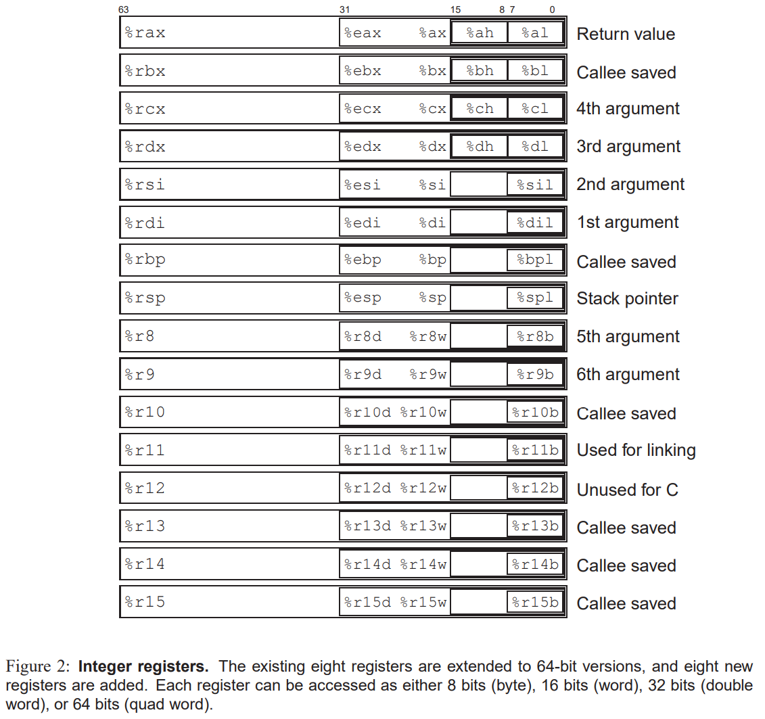
Recap: X86_64 Registers
rip: instruction pointer
=> stores PC

Slide 28
Relocating R_X86_64_64/32[S]
typedef struct { long offset; long type:32, symbol:32; long addend; } Elf64Rela;
Effective address = encoded value encoded value = ([un]signed int/long) (address of(r.symbol) + r.addend) position to modify = (unsigned int/long) (address of(section) + r.offset) # bytes to modify = 4 (32) / 8 (64)
Disassembly of section .data.rel:
0000000000000000 <bufp0>: ...
0: R_X86_64_64 buf [+0]
extern int buf[];
int *bufp0 = &buf[0];
static int *bufp1;
void swap() {
int temp;
bufp1 = &buf[1];
temp = *bufp0;
*bufp0 = *bufp1;
*bufp1 = temp;
}
swap.c

Slide 29
Relocating R_X86_64_PC32
typedef struct { long offset; long type:32, symbol:32; long addend; } Elf64Rela;
Effective address = PC + encoded value encoded value = (unsigned int/long) (address of(r.symbol) + r.addend - (address of(section) + r.offset)) position to modify = (unsigned int/long) (address of(section) + r.offset) # bytes to modify = 4
(PC-4) in the code
Disassembly of section .text:
…
4: e8 00 00 00 00 callq 9 <call+0x9>
5: R_X86_64_PC32 foo-0x4
9: …

Slide 30
Relocating R_X86_64_PLT32
typedef struct { long offset; long type:32, symbol:32; long addend; } Elf64Rela;
Effective address = PC + encoded value encoded value = (unsigned int/long) (address of PLT entry(r.symbol) + r.addend - (address of(section) + r.offset)) position to modify = (unsigned int/long) (address of(section) + r.offset) # bytes to modify = 4
(PC-4) in the code
Disassembly of section .text:
…
: e8 00 00 00 00 callq 9 <call+0x9>
5: R_X86_64_PLT32 foo-0x4
9: …

Slide 31
PC-relative Relocations on Intel Architectures
Why is there an addend of -4 for R_X86_64_PC32 and R_X86_64_PLT32?
When executing an instruction inst_{i}, the PC counter (%eip, %rip) already points to the next instruction inst_{i+1}!
The linker needs to consider this when computing relative PC-offsets The PC (0xe) is 4 bytes ahead of the relocation’s position (0xa), hence 0xe-0xa = 4 must be subtracted from the distance to the target (swap–0xa–4)
int main()
{
swap(…);
return 0;
}
0000000000000000 <main>:
0: 55 push %rbp 1: 48 89 e5 mov %rsp,%rbp
4: b8 00 00 00 00 mov $0x0, %eax
9: e8 00 00 00 00 callq e <main+0xe>
a: R_X86_64_PLT32 swap-0x4
e: b0 00 00 00 00 mov $0x0, %eax
13: 5d pop %rbp
20: c3 retq
…
PC →

Slide 32
Understanding Relocation (main)
$ gcc –c main.c swap.c
$ objdump -r -D main.o
main.c
main.o
int buf[2] =
{1,2};
int main()
{
swap();
return 0;
}
Disassembly of section .text:
0000000000000000 <main>:
0: 55 push %rbp
1: 48 89 e5 mov %rsp,%rbp
4: 48 83 ec 10 sub $0x10,%rsp
8: 89 7d fc mov %edi,-0x4(%rbp)
b: 48 89 75 f0 mov %rsi,-0x10(%rbp)
f: b8 00 00 00 00 mov $0x0,%eax
14: e8 00 00 00 00 call 19 <main+0x19>
15: R_X86_64_PLT32 swap-0x4
19: b8 00 00 00 00 mov $0x0,%eax
1e: c9 leave
1f: c3 ret
…
Disassembly of section .data:
0000000000000000 <buf>:
0: 01 00 add %eax,(%rax)
2: 00 00 add %al, (%rax) 4: 02 00 add (%rax),%al ...
ignore these
instructions

Slide 33
Understanding Relocation (swap)
$ gcc -c main.c swap.c
$ objdump -r -D swap.o
swap.c
swap.o
extern int buf[];
int
*bufp0 = &buf[0];
static int *bufp1;
void swap()
{
int temp;
bufp1 = &buf[1];
temp = *bufp0;
*bufp0 = *bufp1;
*bufp1 = temp;
}
Disassembly of section .text: (gcc 10.3/11.3)
0000000000000000 <swap>:
0: 55 push %rbp
1: 48 89 e5 mov %rsp,%rbp
4: 48 8d 05 00 00 00 00 lea 0x0(%rip),%rax
7: R_X86_64_PC32 buf
b: 48 89 05 00 00 00 00 mov %rax,0x0(%rip)
e: R_X86_64_PC32 .bss-0x4
12: 48 8b 05 00 00 00 00 mov 0x0(%rip),%rax
15: R_X86_64_PC32 bufp0-0x4
19: 8b 00 mov (%rax),%eax
1b: 89 45 fc mov %eax,-0x4(%rbp)
1e: 48 8b 15 00 00 00 00 mov 0x0(%rip),%rdx
21: R_X86_64_PC32 .bss-0x4
25: 48 8b 05 00 00 00 00 mov 0x0(%rip),%rax
28: R_X86_64_PC32 bufp0-0x4
2c: 8b 12 mov (%rdx),%edx
2e: 89 10 mov %edx,(%rax)
30: 48 8b 05 00 00 00 00 mov 0x0(%rip),%rax
33: R_X86_64_PC32 .bss-0x4
37: 8b 55 fc mov -0x4(%rbp),%edx …
Disassembly of section .bss:
0000000000000000 <bufp1>:
...
Disassembly of section .data.rel:
0000000000000000 <bufp0>:
...
0: R_X86_64_64 buf

Slide 34
.data Before/After Relocation
Disassembly of section .bss:
0000000000000000 <bufp1>:
...
Disassembly of section .data.rel:
0000000000000000 <bufp0>:
...
0: R_X86_64_64 buf
$ gcc -o swap main.o swap.o
$ objdump -r -D swap
Disassembly of section .data:
…
0000000000004010 <buf>:
4010: 01 00 add %eax,(%rax)
4012: 00 00 add %al,(%rax)
4014: 02 00 add (%rax),%al
...
0000000000004018 <bufp0>:
4018: 10 40 00 xor %al,0x0(%rax)
401b: 00 00 add %al,(%rax)
401d: 00 00 add %al,(%rax)
... [00]
Disassembly of section .bss:
0000000000004040 <__bss_start>:
...
0000000000004048 <bufp1>:
...
ignore these instructions:
objdump blindly treats
any numbers as instructions
Little endian

Slide 35
.text After Relocation
Disassembly of section .data:
…
0000000000004010 <buf>:
4010: 01 00 00 00
4014: 02 00 00 00
0000000000004018 <bufp0>:
4018: 10 40 00 00 00 00 00 00
Disassembly of section .bss:
0000000000004020 <__bss_start>:
4020: 00 00 00 00 00 00 00 00
0000000000004028 <bufp1>:
4028: 00 00 00 00 00 00 00 00
Disassembly of section .text:
0000000000001125 <main>:
1125: 55 push %rbp
1126: 48 89 e5 mov %rsp,%rbp
1129: 48 83 ec 10 sub $0x10,%rsp
112d: 89 7d fc mov %edi,-0x4(%rbp)
1130: 48 89 75 f0 mov %rsi,-0x10(%rbp)
1134: b8 00 00 00 00 mov $0x0,%eax
1139: e8 07 00 00 00 call 1145 <swap>
113e: b8 00 00 00 00 mov $0x0,%eax
1143: c9 leave
1144: c3 ret
0000000000001145 <swap>: 16404
1145: 55 push %rbp
1146: 48 89 e5 mov %rsp,%rbp
1149: 48 8d 05 c4 2e 00 00 lea 0x2ec4(%rip),%rax # 4014 <buf+0x4>, 4014: &buf[1]
1150: 48 89 05 d1 2e 00 00 mov %rax,0x2ed1(%rip) # 4028 <bufp1>, 4028: bufp1
1157: 48 8b 05 ba 2e 00 00 mov 0x2eba(%rip),%rax # 4018 <bufp0>, 4018: bufp0
115e: 8b 00 mov (%rax),%eax
1160: 89 45 fc mov %eax,-0x4(%rbp)
1163: 48 8b 15 be 2e 00 00 mov 0x2ebe(%rip),%rdx # 4028 <bufp1>
116a: 48 8b 05 a7 2e 00 00 mov 0x2ea7(%rip),%rax # 4018 <bufp0>
1171: 8b 12 mov (%rdx),%edx
1173: 89 10 mov %edx,(%rax)
1175: 48 8b 05 ac 2e 00 00 mov 0x2eac(%rip),%rax # 4028 <bufp1>
117c: 8b 55 fc mov -0x4(%rbp),%edx
117f: 89 10 mov %edx,(%rax)
1181: 90 nop
1182: 5d pop %rbp
1183: c3 ret
Notes:
Note that these are not final addresses! Show in GDB

Slide 36
What the Linker Sees
Before relocation:
After relocation:
0000000000001145 <swap>:
1145: 55 push %rbp
1146: 48 89 e5 mov %rsp,%rbp
1149: 48 8d 05 c4 2e 00 00 lea 0x2ec4(%rip),%rax # 4014 <buf+0x4>
1150: 48 89 05 d1 2e 00 00 mov %rax,0x2ed1(%rip) # 4028 <bufp1>
1157: 48 8b 05 ba 2e 00 00 mov 0x2eba(%rip),%rax # 4018 <bufp0>
115e: 8b 00 mov (%rax),%eax
1160: 89 45 fc mov %eax,-0x4(%rbp)
1163: 48 8b 15 be 2e 00 00 mov 0x2ebe(%rip),%rdx # 4028 <bufp1>
116a: 48 8b 05 a7 2e 00 00 mov 0x2ea7(%rip),%rax # 4018 <bufp0>
1171: 8b 12 mov (%rdx),%edx
1173: 89 10 mov %edx,(%rax)
1175: 48 8b 05 ac 2e 00 00 mov 0x2eac(%rip),%rax # 4028 <bufp1>
117c: 8b 55 fc mov -0x4(%rbp),%edx
117f: 89 10 mov %edx,(%rax)
1181: 90 nop
1182: 5d pop %rbp
1183: c3 ret
Section .text:
55 48 89 e5 48 8d 05 00 00 00 00 48 89 05 00 00
00 00 48 8b 05 00 00 00
00 8b 00 89 45 fc 48 8b
15 00 00 00 00 48 8b 05
00 00 00 00 8b 12 89 10
48 8b 05 00 00 00 00 8b
55 fc …
Section .data.rel:
00 00 00 00 00 00 00 00
Section .rel.text:
7: R_X86_64_PC32 buf
e: R_X86_64_PC32 .bss-4
15: R_X86_64_PC32 bufp0-4
21: R_X86_64_PC32 .bss-4
28: R_X86_64_PC32 bufp0-4
33: R_X86_64_PC32 .bss-4
Section .rel.data:
0: R_X86_64_64 buf
Section .text:
55 48 89 e5 48 8d 05 c4 2e 00 00 48 89 05 d1 2e
00 00 48 8b 05 ba 2e 00
00 8b 00 89 45 fc 48 8b
15 be 2e 00 00 48 8b 05
c6 2e 00 00 8b 12 89 10
48 8b 05 ac 2e 00 00 8b
55 fc …
Section .data.rel:
10 40 00 00 00 00 00 00
The linker does not have (and does not require) any information about the machine code!

Slide 37
Summary
Summary
-------------
-------------
-------------
-------------
-------------
-----

Slide 38
Summary
Symbol Resolution
first step of linking & loading
for each use of a symbol, determine what defined symbol the use refers to
(used to be) a source of subtle errors
global, local, and external, strong and weak symbols
symbol data to ELF section assignment: .text, .data, .bss
Symbol Relocation
merge object files into a single executable/library
relocate at-compile time unknown addresses/offsets to point to correct memory location
two relocations of interest to us
PC-relative (R_X86_64_PC32/PLT32)
Absolute (R_X86_64_32[S]/64)
Remember that the PC always points to the next instruction on Intel architectures

